Slide 1
WILLIAM PATERSON UNIVERSITY
WELCOME
Together, we’ll do this

Slide 2
The information contained in this presentation is for WP at Mercer students ONLY!

Slide 3
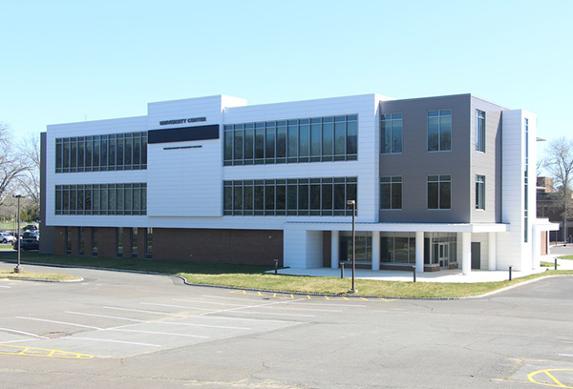
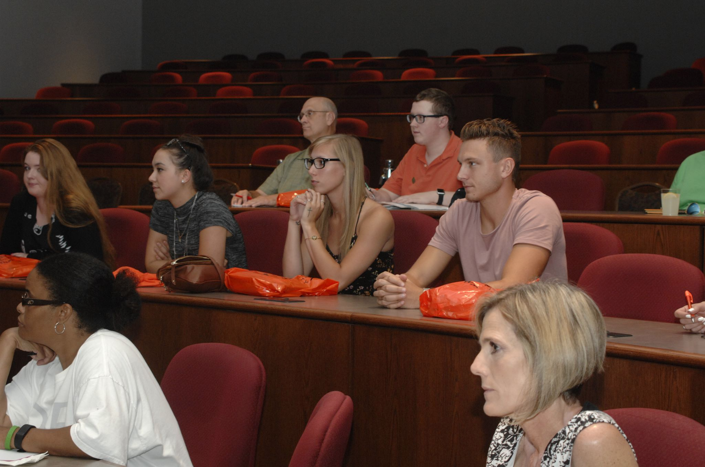
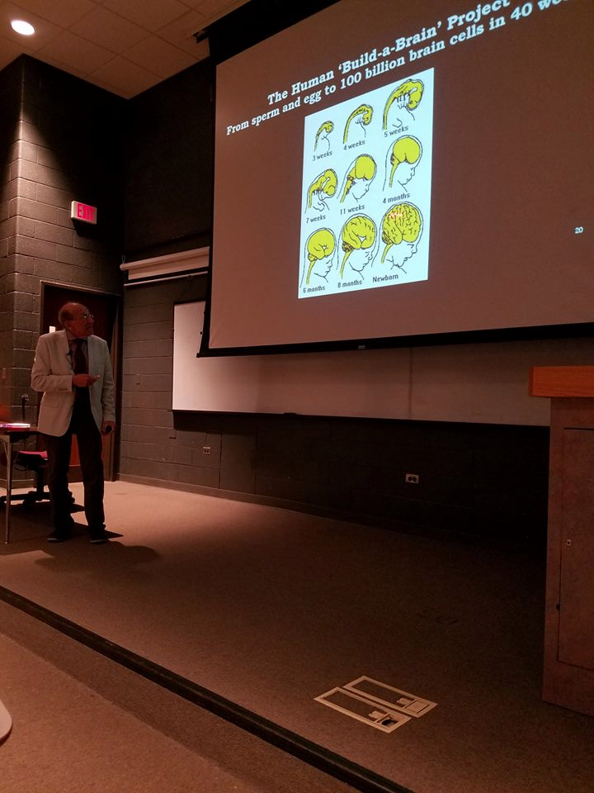
WP at Mercer

Slide 4
Our website: www.wpunj.edu/mercer

Slide 5
WP Connect: Overview
WP Connect is your student portal
Use it to access your schedule, WPU e-mail account, add and drop classes, view your degree audit, review financial aid, and view and pay your bill
Access Blackboard which is the tool for accessing on-line courses (See presentation link at www.wpunj.edu/mercer)

Slide 6
WP Connect: Log In

Slide 7
WP COnnect

Slide 8
Look Up Course Offerings

Slide 9
Register for classes
ALL WP at Mercer classrooms are found in WP Connect (Banner Self-Service)
Click on the 5 digit CRN number and it will tell you the room location at Mercer
All Mercer classroom courses are either sections 78 and 79
Section 88 or 89 are on-line courses for Mercer students only
Section 80 classes are on-line courses open to all WPU students including WPU at Mercer students

Slide 10
Course Details

Slide 11
Transfer Info
Must have an AA , AS or AFA degree from a Community College before the first day of classes at WPU at Mercer in order for all transfer credits to be accepted.
Must validate your AA , AS or AFA degree by sending the Admissions Department a final transcript with your degree posted on it by October 15, 2023 (Referenced on the cover letter in your Student Packet).
Transfer credit is given for all earned credits except in such cases where the earned grade does not meet the minimum requirements. There is no limit to the number of credits that may be transferred, however, students must complete a minimum number of credits at WP and must satisfy course and grade requirements established for their WP program of study.

Slide 12
Degree Audit

Slide 13
Additional Info
Summer and Winter courses accelerate your degree. Save time and money!
Visiting Student Form and Financial Aid Consortium Agreement
Scholarships-For Incoming and Continuing WP Students-FAFSA submission required
For scholarship continued eligibility students must take 12 WP credits each term ( in addition to any MCCC credits)
Book store Deferment-section 80 classes
Follow us on social media! Facebook, Twitter, & Instagram. Share your experiences and find information about campus and club events. Check your email for links.
WPU at Mercer website/tuition and fees
FERPA release form (federal privacy act of 1974)
For information regarding services for students requiring special accommodations, please see the presentation on the Accessibility Resource Center at www.wpunj.edu/mercer.

Slide 14
World Language Requirement
In keeping with William Paterson University’s mission to graduate students who embody “active involvement in a multicultural world,” all students are required to demonstrate competency in a language other than English, either by 1) completing up to six (6) credits of a single world language (or American Sign Language), or 2) by demonstrating, via a test, intermediate proficiency in the selected language.
It is to the student’s advantage to take the placement test. You might be waived from the language requirement!
Students who wish to fulfill the world language requirement by taking a proficiency test have the following options:
Challenge Exam, Transfer credits, NYU Proficiency Test, Exemptions
Any questions please contact James Miles at milesj@wpunj.edu to have your question directed to the correct person.

Slide 15
WP I.D. CARDS
College ID is important for participating in events at both the WP Mercer and Wayne campuses.
College ID’s- all WP at Mercer students will have two ID’s- a Mercer ID and a WP ID.
See How To Get A WP ID & Mercer ID cards on our website www.wpunj.edu/mercer

Slide 16
Contact Information
For more information on the degrees offered at WP at Mercer, visit the website: www.wpunj.edu/mercer
Dr. Gwendolyn Wood
WP at Mercer On-site Coordinator
MCCC University Center Room 119
mercer@wpunj.edu
Dr. Patrick Noonan
Director of Transfer Programs and Special Sessions
William Paterson University
Wayne, NJ 07470
973-720-3080 office
noonanp@wpunj.edu

